Slide 1
Temă-logică computațională
Temă realizată de Suciu Andrei
Grupa 216

Slide 2
Problema 9.3.5 (subpunctul 6)
Simplificaţi următoarele funcţii booleene de patru variabile date prin valorile de 1, utilizând metoda lui Quine:
f6(1,1,0,1)=1, f6(0,1,0,1)=1, f6(0,1,1,1)=1, f6(1,1,1,0)=1, f6(0,1,1,0)=1, f6(1,0,1,0)=1, f6(1,0,1,1)=1, f6(1,0,0,1)=1;
S_{f}={(1,1,0,1),(0,1,0,1),(0,1,1,1),(1,1,1,0),(0,1,1,0),(1,0,1,0),(1,0,1,1),(1,0,0,1)}
1.Ordonăm mulțimea suport a funcției descrescator după numărul de valori de 1
S_{f}={(1,1,1,0),(1,1,0,1),(1,0,1,1),(0,1,1,1),(1,0,1,0),(1,0,0,1),(0,1,1,0),(0,1,0,1)}

Slide 3
fACTORIZAREA
S_{f}={(1,1,1,0),(1,1,0,1),(1,0,1,1),(0,1,1,1),(1,0,1,0),(1,0,0,1),(0,1,1,0),(0,1,0,1)}
Grupul
I √
√ Mulțimea monoamelor maximale:
√
√
II √
√
√
√
III=I+II
X1 X2 X3 X4
1 1 1 0 m₁₄
1 1 0 1 m₁₃
1 0 1 1 m₁₁
M(f)={x₁x₃x₄, x₂x₃x₄, x₁x₃x₄, x₂x₃x₄, x₁x₂x₃, x₁x₂x₄, x₁x₂x₄,
x₁x₂x₃}
={max₁,max₂,max₃,max₄,max₅,max₆,max₇,max₈}
0 1 1 1 m₇
1 0 1 0 m₁₀
1 0 0 1 m₉
0 1 1 0 m₆
0 1 0 1 m₅
1 - 1 0 m₁₄ v m₁₀
=x₁x₃x₄=max₁
- 1 1 0 m₁₄v m₆
1 - 0 1 m₁₃ v m₉
=x₂x₃x₄=max₂
=x₁x₃x₄=max₃
- 1 0 1 m₁₃ v m₅
=x₂x₃x₄=max₄
1 0 1 - m₁₁v m₁₀
=x₁x₂x₃=max₅
1 0 - 1 m₁₁ v m₉
=x₁x₂x₄=max₆
0 1 - 1 m₇ v m₅
0 1 1 - m₇ v m₆
=x₁x₂x₄=max₇
=x₁x₂x₃=max₈

Slide 4
Identificarea monoamelor centrale
Monoame Maximale mintermi | max₁ | max₂ | max₃ | max₄ | max₅ | max₆ | max₇ | max₈
m₅ |  |  |  | * |  |  | *
m₆ |  | * |  |  |  |  |  | *
m₇ |  |  |  |  |  |  | * | *
m₉ |  |  | * |  |  | *
m₁₀ | * |  |  |  | *
m₁₁ |  |  |  |  | * | *
m₁₃ |  |  | * | *
m₁₄ | * | *

Slide 5
Mulțimea monoamelor centrale
Nu avem nici o linie cu o singura steluta:
C(f)=Ø
Ne aflăm în cazul:III

Slide 6
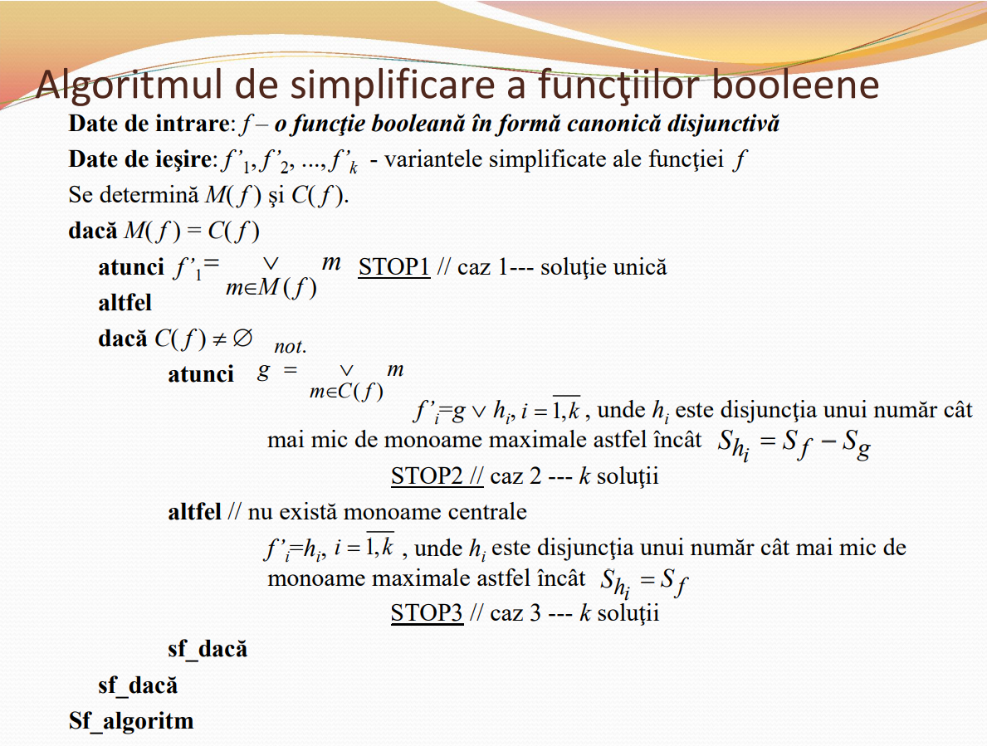

Slide 7
Monoame Maximale mintermi | max₁ | max₂ | max₃ | max₄ | max₅ | max₆ | max₇ | max₈
m₅ |  |  |  | * |  |  | *
m₆ |  | * |  |  |  |  |  | *
m₇ |  |  |  |  |  |  | * | *
m₉ |  |  | * |  |  | *
m₁₀ | * |  |  |  | *
m₁₁ |  |  |  |  | * | *
m₁₃ |  |  | * | *
m₁₄ | * | *

Slide 8
Monoame Maximale mintermi | max₁ | max₂ | max₃ | max₄ | max₅ | max₆ | max₇ | max₈
m₅ |  |  |  | * |  |  | *
m₆ |  | * |  |  |  |  |  | *
m₇ |  |  |  |  |  |  | * | *
m₉ |  |  | * |  |  | *
m₁₀ | * |  |  |  | *
m₁₁ |  |  |  |  | * | *
m₁₃ |  |  | * | *
m₁₄ | * | *

Slide 9
Forma simplificata a fiunctiei:
f₁’(x₁,x₂,x₃,x₄)=max₂ v max₃ v max₅ v max₇ = x₂x₃x₄ v x₁x₃x₄ v x₁x₂x₃ v x₁x₂x₄
f₂’ (x₁,x₂,x₃,x₄)= max₁ v max₄ v max₆ v max₈ =x₁x₃x₄ v x₂x₃x₄ v x₁x₂x₄ v x₁x₂x₃

Slide 10
Mulțumesc pentru atenție

